Slide 1
Requirement Gathering & Analysis
System Analysis and Design
Content 03

Slide 2
SDLC Steps
Idea Generation (optional)
Planning
System Information/Requirement Gathering
Analysis
Design
Development/Construction/Coding
Testing
Deployment
Post–Implementation & Maintenance

Slide 3
Requirements Gathering & Analysis
Information Sources
Information Gathering
Comparison
Gap Analysis
Feature List Fixation

Slide 4
Requirements Gathering & Analysis
Information Sources
Information Gathering
Comparison
Gap Analysis
Feature List Fixation

Slide 5
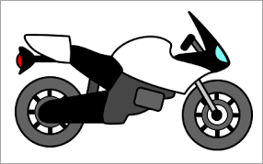
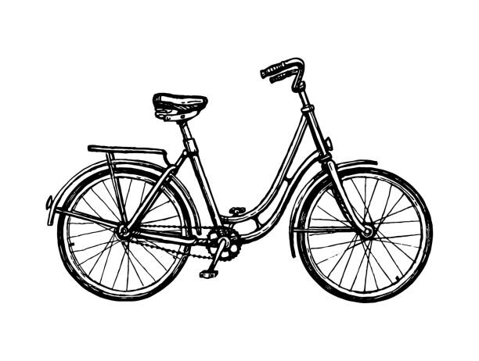
Why do we need this phase?
Sometimes (a lot of times actually), the end-product does not fully comply with what the customer/end-user had expected.
Client Expectation
Client Receives

Slide 6
Importance of Requirements Analysis
Aligns with Business Goals – It makes sure the software meets company objectives and operational needs.
Enhances User Satisfaction – Involving users in development results in a product that meets their expectations.
Saves Time & Money – Clear requirements reduce miscommunication, rework, and costly delays.
Compliance & Regulations – Ensures software meets legal standards, avoiding fines and legal issues.
Traceability & Documentation – Links software components to requirements, aiding audits and updates.

Slide 7
Types of Requirements
Functional Requirements
Describe what the system must do
Define features, behaviors, or tasks
Non-Functional Requirements
Describe how the system should perform
Define quality attributes

Slide 8
Good requirement characteristics
A good requirement should be:
Clear
Specific
Complete
Consistent
Measurable/Testable
Feasible
Traceable
Modifiable

Slide 9
User stories vs Use cases
User Stories
Short, simple description of a user need
Format: As a <user>, I want <goal> so that <reason>.
Focus on user perspective
Use Cases
Detailed description of interactions between user and system

Slide 10
Requirement Ambiguity
Ambiguity means a requirement can be understood in more than one way.
Why remove ambiguity?
To avoid misunderstandings
To reduce rework and errors
To make requirements testable and clear
Common sources of ambiguity
Vague terms: “fast”, “secure”, “user friendly”, “as soon as possible”
Missing conditions or exceptions
Ambiguity must be removed before developing a system

Slide 11
Types of Information
To develop accurate requirements, we first need complete and reliable information.
About Organization
About Human Resources
About Works

Slide 12
Types of Information
1. About Organization
Vision – Defines what the organization aims to become in the future, guiding its long-term direction.
Mission – Explains why the organization exists, its purpose, and the value it provides to society.
Goals – Specific, measurable targets that help achieve the vision and mission.
Policies – Rules and guidelines ensuring ethical conduct, compliance, and smooth operations.
Organizational Structure – Defines roles, responsibilities, and hierarchy for efficient workflow.

Slide 13
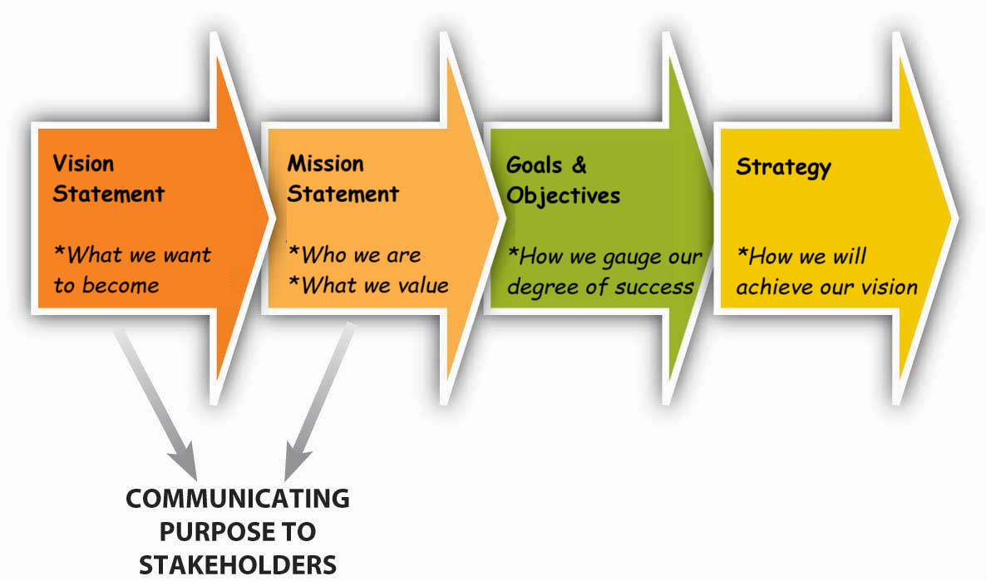
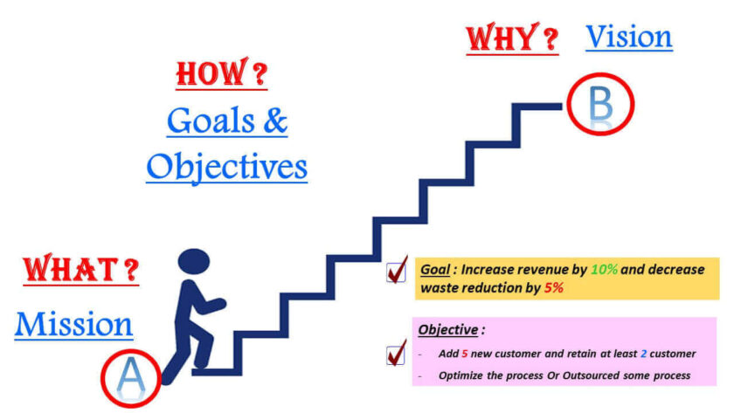
Types of Information
About Organization

Slide 14
Types of Information
2. About Human Resources/Users
Type of user
(Manager/Executive/Supervisor etc)
Job Responsibilities
(Role Management)
Interpersonal Relationships

Slide 15
Types of Information
3. About Works
List of works/activities
Process flow of works/tasks
Methods/Procedures/Business rules
Work Schedule

Slide 16
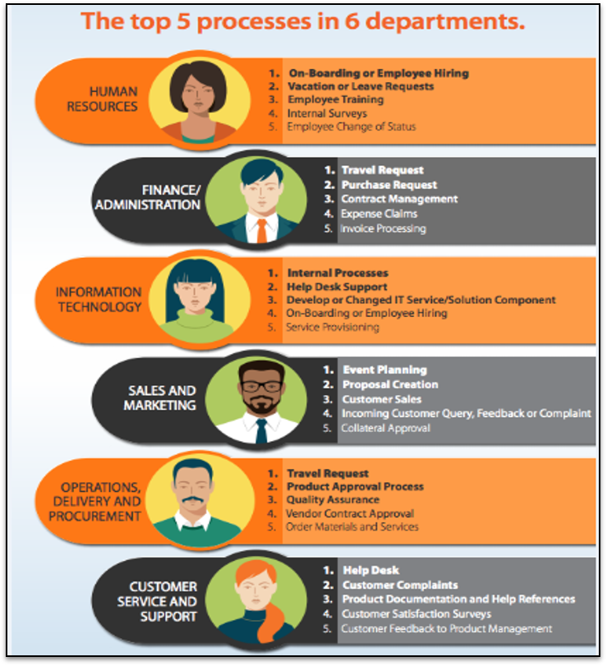
Roles & Job Responsibilities
Who are the most common types of users, and what roles do they have in the company?
Business Analysts, System Analysts, Product Owners and Project Managers are mainly responsible for meeting with stakeholders and clients, and jotting down the project’s requirements, goals and scope.

Slide 17
Major Steps of Information Gathering
Identifying the sources of information
Determining the effective tools
Using best practices of the different tools

Slide 18
Sources of Information
Internal Sources (for existing organization)
Existing/official documentations
Personnel / Staff
Existing users / customers
External Sources
Benchmark products
Online reports / write-ups
Research papers / Online articles
Related authorities / experts

Slide 19
Categorize the following sources of information
Benchmark Products Study
Newspapers & Professional Journals
Personal Staff
Professional/ Consultant
System Documentation
The Users
Reports and Transaction Document
Vendors/ Suppliers
Government Documents
Online

Slide 20
Categorize the following sources of information
Benchmark Products Study - External
Newspapers & Professional Journals - External
Personal Staff - Internal
Professional/ Consultant – Internal/External
System Documentation- Internal
The Users – Internal/External
Reports and Transaction Document - Internal
Vendors/ Suppliers - External
Government Documents - External
Online - External

Slide 21
Information Gathering Tools
Review Documents, Procedures, Forms, etc.
On-site Observation
Interview
Questionnaires
JAD (Joint Application Development)
Online (benchmark products, literature, etc.)

Slide 22
1. Review Documents, Procedures, Forms
First step of Information Gathering (for existing organizations)
Going through Company Documentations, Manuals, Rules, Forms, Meeting, Government Rules, Yearly Reports etc.
Will be able to find the General Standards of the system.

Slide 23
1. Review Documents, Procedures, Forms
Merits
Demerits
Very useful for initial concept
Up-to-date manual saves hours of time.
It can determine the basic requirements
Printed forms are useful in UI designing
Outdated Manuals can not represent the current system
Can not deliver all the required information on a system
Time-consuming
Need clearance / Need to maintain confidentiality

Slide 24

2. On-Site Observation

Slide 25
2. On-Site Observation
Recognizing and noting people, objects and the environment along with the activities
Major objective is to get as close as possible to the real system being studied
Analyst (the one tasked with the on-site observation) is expected to be detached from the system which is being observed.
Carried out in-person, through video recordings, labs, etc.
Two types of observation:
Obtrusive: People know they are being observed.
Unobtrusive: People do not know they are being observed.

Slide 26
2. On-Site Observation
Merits
Demerits
Real-time Information
Contextual Understanding
Allows a closer connection with the organization
Exact problem could be identified
Attitudes and motivations may not be observed properly, rather, only the actions are observed
In-depth analysis is missing
Respondents may behave differently due to presence of observer
Time-consuming

Slide 27

3. Interviews
A face-to-face situation in which a person (interviewer) asks a designated person being interviewed (interviewee) relevant questions which are designed to gather information about a problem area

Slide 28
3. Interviews
Merits
Interviewing the right person for analyzing the system is a very fast process.
An effective technique for eliciting information about the complex subjects.
Its flexibility makes the interview a superior technique for exploring areas where not much is known.
Can have follow-up questions based on previous responses
Demerits
Long preparation time
Takes long time to conduct
Need skilful person to conduct
Several interviews each with several people, involving more money and time

Slide 29
Steps to Conduct a Good Interview
1. Select Interviewees
Can be any important stakeholders
Learn about the interviewee’s background prior to the interview
2. Prepare for the interview
Familiarize yourself with the agenda
Prepare a checklist of questions
3. Conduct the interview
Summarize the problem
Provide incentive for the interviewee to respond
Collect the responses
4. Summarize the interview session
Summarize the key points and insights from the interview

Slide 30
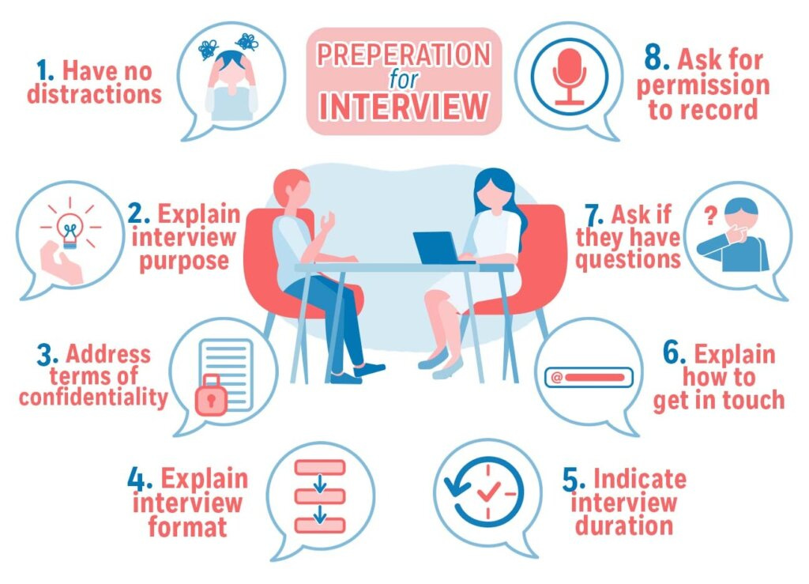
Preparation to Conduct a Good Interview

Slide 31
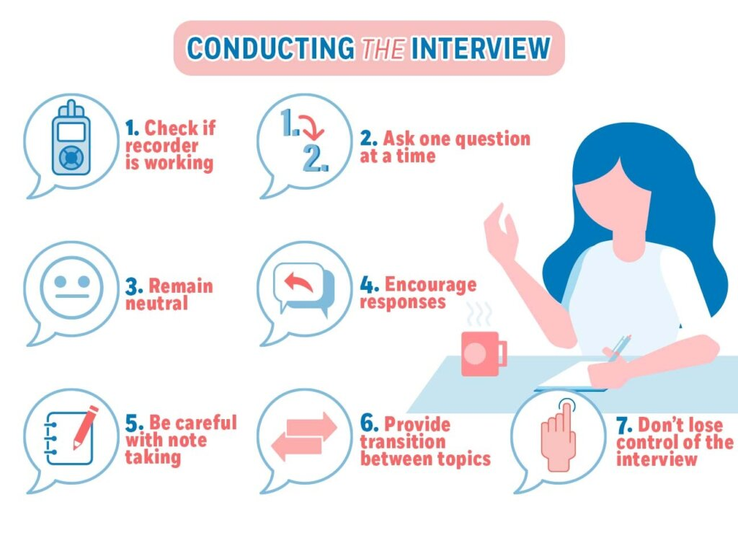
Steps to Conduct a Good Interview

Slide 32
Common Tips To Conduct Interviews
Don’t jump into asking questions. Greet the interviewee and introduce yourself. Set the stage gradually.
Establish rapport (Be welcoming). Put the interviewee at ease.
Know what to ask and what not to.
Phrase the questions clearly and concisely.
Listen more, talk less.
Take notes, audio/video recording, if possible and if allowed.
Ask open-ended questions (don’t give choices, rather, expect long-form answers)
Don’t ask leading/loaded questions (questions structured in a way that tend to shift the opinion of the interviewee into a certain direction)
Avoid threatening questions
Converge the interview with a summary with reviewing feedbacks.

Slide 33
Sample Tips To Conduct Interviews (Dos and Don’ts)
It is obvious to us that AI has had tremendous impact over the last two years since ChatGPT came under the spotlight. Do you think AI will be integrated into various field of work in the future?
Given the popularity of AI-run platforms over the recent past, do you think it will have even more impact in other industries?
Between veganism, vegetarianism and non-vegetarianism, which would you choose?
What kind of eating habits do you prefer?
The recent update to the UIU website seems fantastic, don’t you think so?
What do you think about the recent update to the UIU website?

Slide 34
Sample Tips To Conduct Interviews
We have reached the end to our questions. Thank you for your time. (Don’t conclude the interview instantly. Recap the interview with the questions and responses in order to give the interviewee an opportunity to modify their responses)
We have reached the end to our questions. Before concluding, let me summarize this session.
Regarding the pollution crisis, your opinion was … .
When it comes to reducing the carbon footprint, you said your company is carrying out … .
In the future, you plan on … .
I hope I have gotten everything noted down correctly. If needed, I would like to conduct a follow-up interview if it is okay with you, given your busy schedule. Thank you so much for your time.

Slide 35
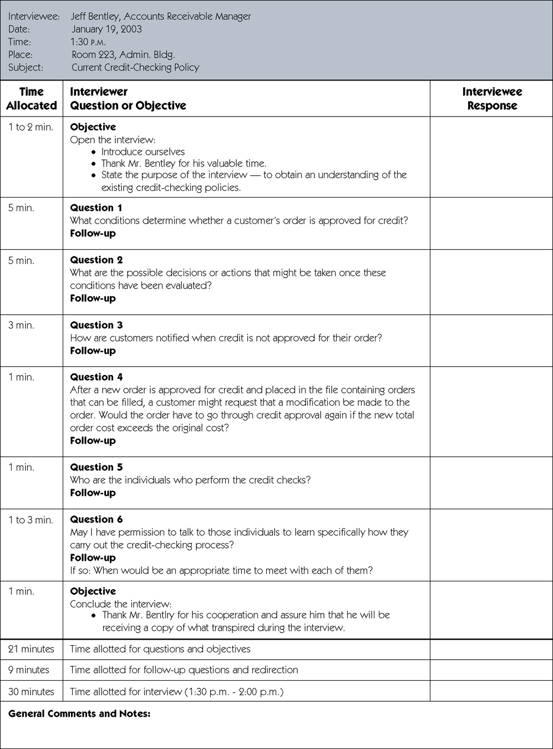
Sample Guide To Conduct Interviews

Slide 36

4. Questionnaires
A list of questions or items used to gather data from respondents about their attitudes, experiences, or opinions. Can collect both qualitative and quantitative data.
Types of questions
Short Answers (one-line or one-word answers)
Long Answers (paragraph) [not suggested]
Multiple Choice Questions
True/False
Fill in the blanks
Checkboxes
Linear Scale (1 to 5)

Slide 37
4. Questionnaires
Merits
Economical and requires less skill to administer
Maintains anonymity
Can target mass audience
Easier data collection and analysis
Demerits
Low response rates
Includes bias and subjectivity
Mostly short answers (No elaboration)
No option to clarify doubts on both ends
Requires knowledge of possible answers (‘Other’ provides no significant information)
Uninterested participants or participants with insufficient knowledge will participate anyway, resulting in inaccurate data

Slide 38
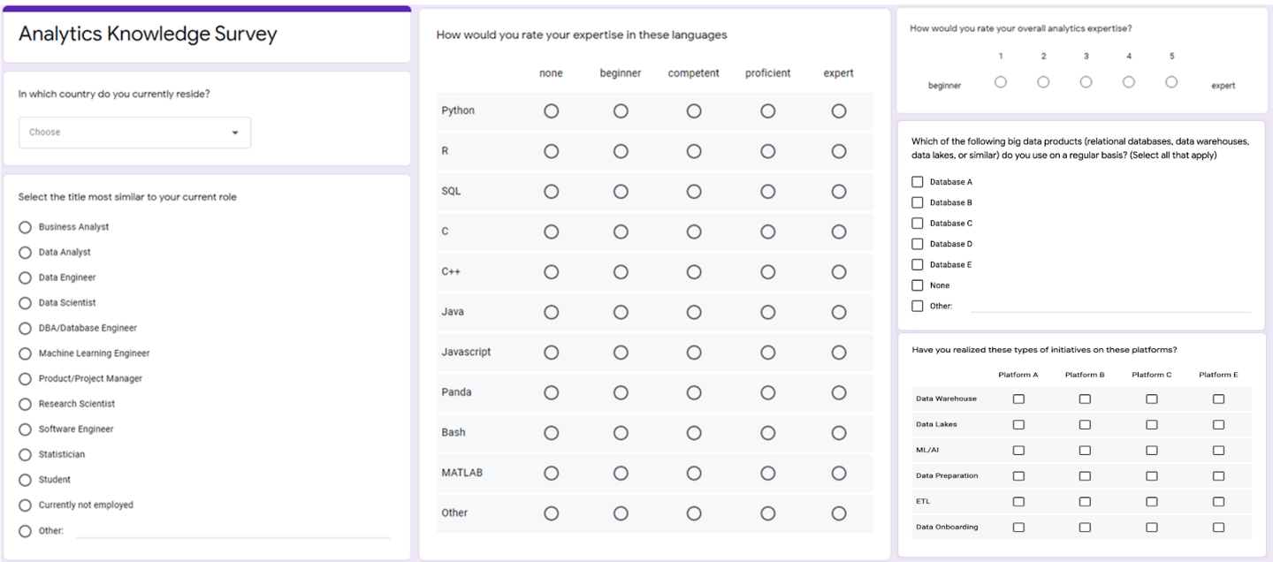
Sample Requirement Analysis Survey Questions

Slide 39
5. Joint Application Development
A methodology that involves the client or end user in the design and development of a software application through a succession of collaborative workshops called JAD sessions. Its aim is to involve the customer (or end user) in defining the business needs and developing a solution based on those needs.
Focuses on team-based development and group consensus.
Helps define business needs and develop solutions with user involvement.
Best for projects where group agreement is more important than individual opinions.

Slide 40
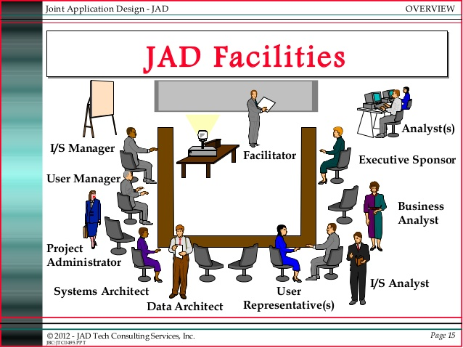

Slide 41
5. Joint Application Development
Participants of JAD sessions:
Executive Sponsor (Someone in a decision-making capacity)
JAD Facilitator
Users (many type of users)
IT Representatives
Scribes
Observers

Slide 42
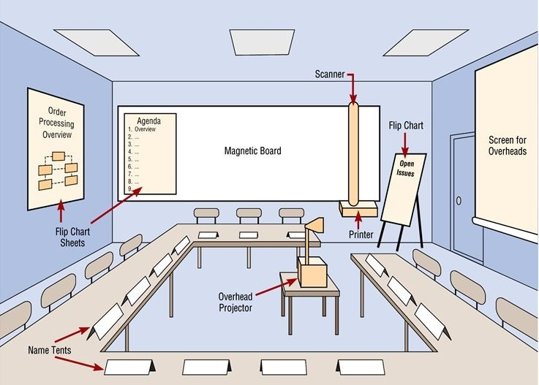
5. Joint Application Development

Slide 43

6. Online
Online information gathering tools refer to various digital methods and technologies used to collect, analyze, and manage data from online sources.
Online articles, books, reviews, academic papers and benchmark products can help set the standard.

Slide 44

6. Online (Different Online Source)
Web Scraping
Surveys
Social Media Monitoring
Databases & Repositories
Search Engines
Online Libraries
Analytics Tools
Forums & Communities

Slide 45
Benchmark Study
Products of competitors
Product benchmarking is the process of testing your products against those of your competitors, in order to find out where your product ranks in terms of consumer preference.
Compare with past performance, identify and compare key metrics, know the industry standard

Slide 46
Benchmark Study
Merits
Keep improving internal operations
Understand what’s working and what isn’t
Adopt or improve upon competitors’ practices
Focus on practices and offerings that promote customer satisfaction and loyalty
Demerits
Tough to identify good and specific benchmark products
Challenge to find reliable and pertinent data
Copying or imitating others without taking into account your own strengths, weaknesses and uniqueness can be a risky endeavor.
Comparing to unrealistic or unsuitable benchmarks can be disheartening and misleading

Slide 47
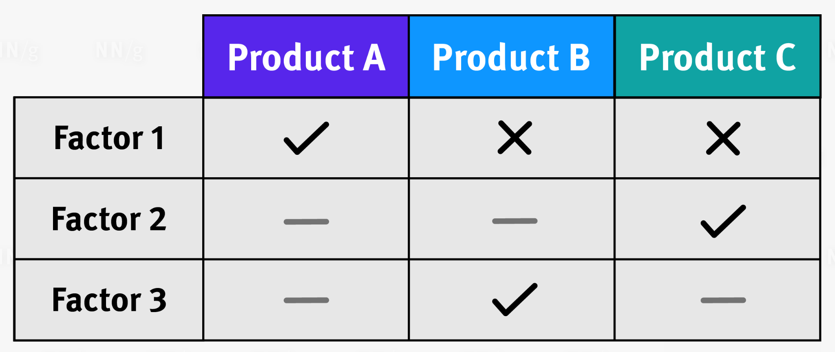
Comparison Table
A table that uses columns for products (or services) and rows for the attributes.
Allows for quick and easy comparison between each offering’s features and characteristics.

Slide 48
Comparison Table - Steps To Create
Select a subject to benchmark
Decide which organizations or companies you want to benchmark
Document your current processes
Collect and analyze data
Measure your performance against the data you’ve collected

Slide 49
Comparison Table - When You Don’t Need It
Not mutually exclusive (a consumer probably doesn’t need a comparison table to help them choose a dress, because they can buy multiple dresses from multiple stores)
Simple (coffee mug doesn’t have many meaningful, comparable attributes)
Cheap or replaceable (not worth the time comparing the attributes of a pen)
Unique or hard to compare

Slide 50
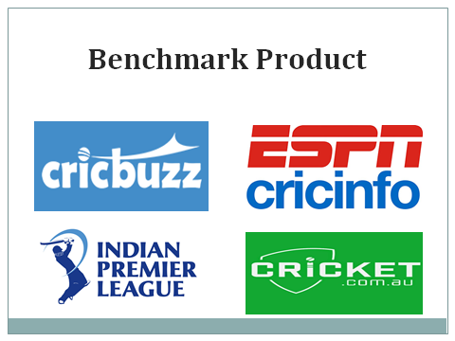

Slide 51





Comparison | Cricinfo | Cricbuzz | Australian Cric | IPL | Proposed system (BCL)
Team Name
News
Result
Fixture
Live Scores
Login
Search
Blog
Videos
Ticket
Point table

Slide 52
Team Name Feature | Cricinfo | Cricbuzz | Australian Cric | IPL | Proposed system (BCL)
News | ✔ | ✔ | ✔ | ✔ | ✔
Result | ✔ | ✔ | ❌ | ✔ | ✔
Fixture | ✔ | ✔ | ✔ | ❌ | ✔
Live Scores | ✔ | ✔ | ✔ | ❌ | ✔
Login | ✔ | ✔ | ✔ | ❌ | ✔
Search | ✔ | ✔ | ✔ | ✔ | ✔
Blog | ✔ | ✔ | ✔ | ❌ | ✔
Videos | ✔ | ✔ | ✔ | ✔ | ✔
Ticket | ❌ | ❌ | ✔ | ✔ | ✔

Slide 53
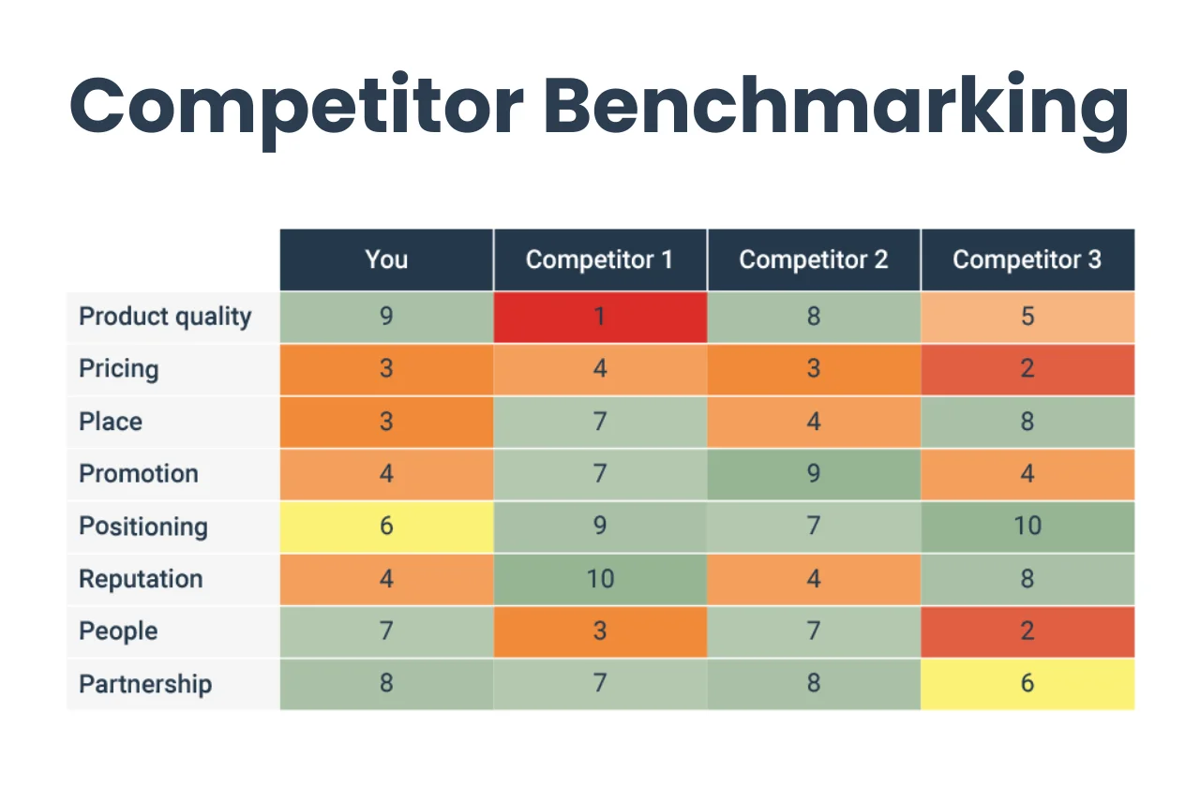
Online - Benchmark Products

Slide 54
Steps for Feature List Fixation
Benchmarks show us what good systems achieve. To reach that level, we must first identify which features are essential.
Steps for Feature List Fixation:
Prioritize requirements to identify what matters most
Conduct gap analysis to find what is missing or needs improvement
Perform SWOT analysis to understand internal and external factors
Do stakeholder analysis to ensure all needs and expectations are aligned

Slide 55
Importance of Prioritizing Requirements
Prioritizing requirements means deciding which requirements are most important and should be implemented first.
Resources are limited
Not all requirements are equally critical
Helps manage stakeholder expectations
Reduces project risk
Supports better planning

Slide 56
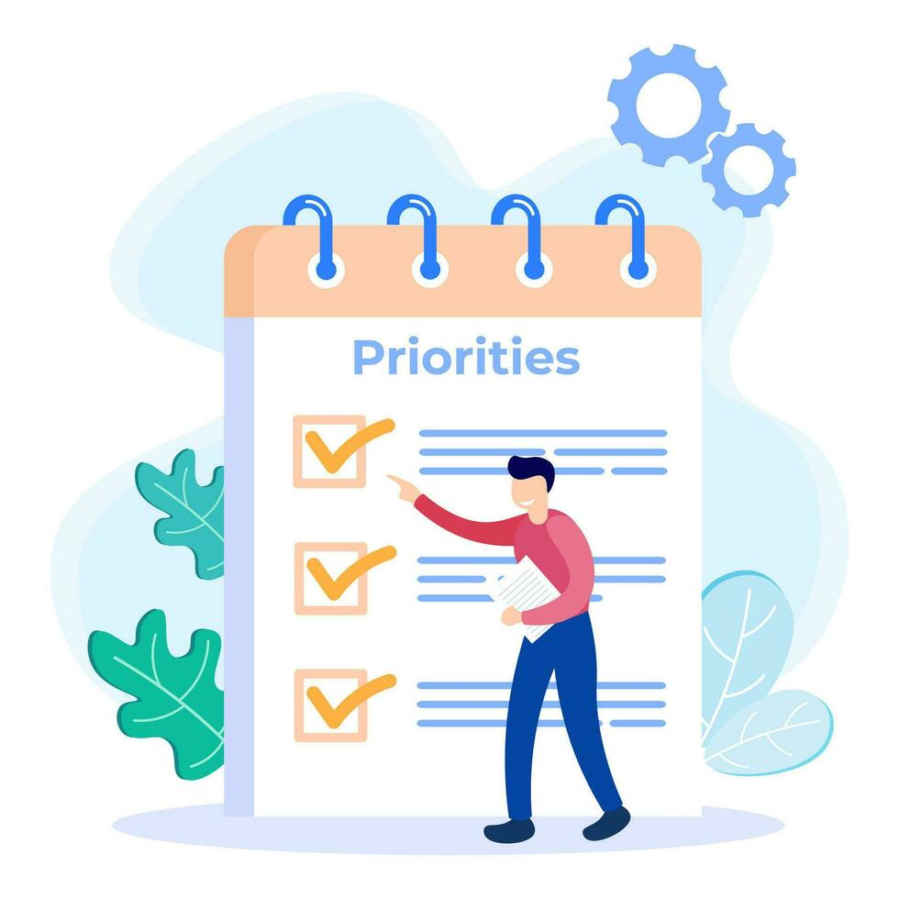
Common Approaches to Prioritizing Requirements
MoSCoW Method
Kano Model

Slide 57
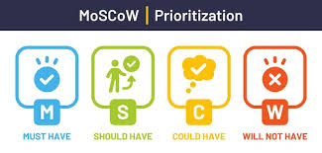
MoSCoW Method
MoSCoW divides requirements into four groups:
Must Have : Essential features; without them, the system fails.
Should Have : Important but not absolutely critical; can be delivered later if needed.
Could Have : Useful but optional; included only if resources allow.
Won’t Have (for now) : Out of scope for the current release.
This method helps teams make clear decisions and avoid confusion.

Slide 58
Kano Model
The Kano model categorizes features based on customer satisfaction:
Basic Needs : Expected features; their absence causes dissatisfaction, but presence does not excite users.
Performance Needs : The more you improve them, the more satisfied users become.
Delighter Features : Unexpected features that pleasantly surprise users.
This approach helps decide which features make customers happiest.

Slide 59

Gap Analysis
After prioritizing requirements using MoSCoW and the Kano model, the next step is to identify what is missing or incomplete.
This leads us to Gap Analysis

Slide 60
Understanding Gap Analysis
A method of assessing the performance of a business unit to determine whether business requirements or objectives are being met and, if not, what steps should be taken to meet them
Used by project managers and process improvement teams as the starting point for an action plan to produce operational improvement
Helps in benchmarking actual business performance so it can be measured against optimal performance levels
Can be identified from benchmark products, academic papers, online articles, stakeholders’ expectations, etc

Slide 61
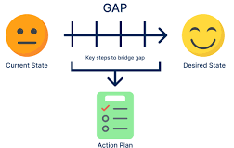
Steps in Gap Analysis
The process of gap analysis involves four main steps:
Identify Current State
Define Desired State
Analyze Gaps
Develop Action Plans

Slide 62
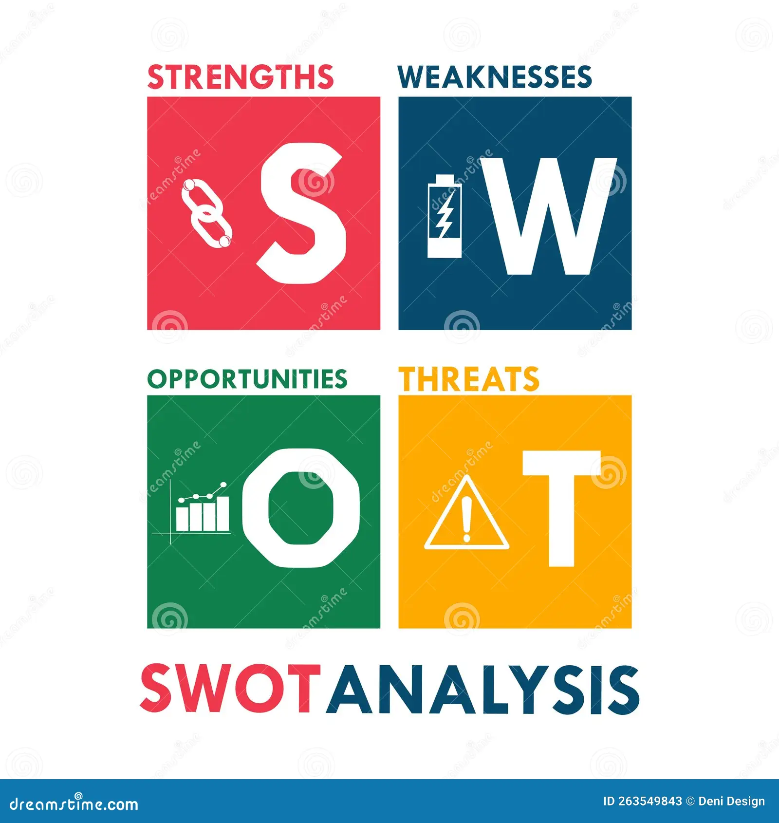
SWOT Analysis
Provides a quick strategic view to support decisions and risk planning.
Strengths
Weaknesses
Opportunities
Threats

Slide 63



Stakeholder Analysis
Identify who matters, what they want, and how to engage them.
Before finalizing the feature list, we must first conduct a Stakeholder Analysis to understand everyone’s needs and expectations.a

Slide 64

Feature List Fixation
Now that we have gathered the necessary information and gone through some form of analysis, we can reliably fix our feature list with justification.
Try to Cover All possible Features found in Gap Analysis
Try to Cover All possible Standard Features that exist in the Benchmark Products

Slide 65
Feature List Fixation - Example
Team Name (International , Domestic , BPL)
Result ( Result of the matches)
Fixture (The time schedule of matches)
Live Score ( Live scores of running matches)
Login ( You can LOGIN as an Admin and an user)
Search ( You can search through Matches , Teams , Player name)
Series ( Which series are going on now)
Point Table ( The point table of Teams )
Ticket ( Online E-Ticket system for booking )
Videos ( Videos of the matches , toss , wickets , Highlights etc.)
News ( News about matches , series etc.)
Photos ( Photos of matches , Players etc. )

Slide 66
Feature List Fixation - With Respect To Stakeholders
Admin
Activity 1
Activity 2
User
Activity 1
Activity 2
Guest
Sponsors

Slide 67
https://www.softwaretestinghelp.com/requirement-analysis-in-sdlc/
https://www.geeksforgeeks.org/software-engineering-requirements-elicitation/
https://open.lib.umn.edu/strategicmanagement/chapter/2-2-vision-mission-and-goals/
https://www.withum.com/resources/digital-workflow-benefits-for-every-department-in-your-organization/
https://jobs.washingtonpost.com/article/differences-in-prepping-for-an-in-person-vs-virtual-interview/
https://www.yourarticlelibrary.com/management/mis-management/tools-of-information-gathering-for-system-analysis/70398
https://www.1000sourcecodes.com/2012/06/sad-information-gathering-tools.html
https://management.org/businessresearch/interviews.htm
https://www.formpl.us/blog/good-bad-survey
https://www.techtarget.com/searchsoftwarequality/definition/JAD
https://www.britannica.com/technology/Internet
https://www.wisdomtree.com/investments/blog/2023/12/18/5-cutting-edge-innovations-redefining-battery-technology-right-now
References

Slide 68
https://wssintl.com/services/product-benchmarking/
https://www.businessnewsdaily.com/15960-benchmarking-benefits-small-business.html
https://www.linkedin.com/advice/1/what-advantages-disadvantages-benchmarking
https://www.nngroup.com/articles/comparison-tables/
https://www.lucidchart.com/blog/8-steps-of-the-benchmarking-process
https://www.techtarget.com/searchcio/definition/gap-analysis
References

Slide 69
Thank You

